Slide 1
E-Commerce app presentation
Devana Sherrod
Project 2
User Experience and Interface Design
Spring 2024 UMGC

Slide 2
Project overview
The interface I'm designing will be a shopping application for an accessory and clothing brand. The app will allow users to browse inventory, make purchases, create an account, and feature a virtual try-on experience to reduce returns.

Slide 3
APP trends research
If you have an online store, it’s a great idea to create a mobile app! The next few slides are just a few of the top benefits and trends in e-commerce and mobile applications.
One Click Ordering:
“97% of mobile site shopping carts are abandoned. But the shopping cart abandonment rate from mobile apps is just 20%. How is this possible? Both instances are occurring from the same device. Yet mobile apps have the lowest abandonment rates. An ecommerce mobile app allows you to store customer information to their user profile. So when it’s time to buy, they don’t need to enter those tedious details every time manually. One-click ordering makes it possible for customers to complete the entire purchase process in, you guessed it, one click. This is a win-win scenario for both parties."
"Customers shopping in an app spend twice as much as customers buying from a desktop device or mobile website.”
References cited on slide 25

Slide 4
APP trends research
Fraud Reduction:
“With mobile usage trending upward over the years, it makes sense that mobile fraud would follow suit and increase as well. While no person or business is ever 100% immune from fraud, there are definitely steps you can take to prevent it. Creating an ecommerce mobile app for your Shopify store is the first step. Apps are less susceptible to phishing scams and other common attacks that occur from mobile web browsers. By nature, the anatomy of an app is more secure as well. Customers won’t have to manually enter their payment information for each transaction, as we discussed earlier. An app can safely store all customer and payment data to protect it from a possible breach. Apps can set up security features like two-factor authentication as an added layer of protection.”

Slide 5
APP trends research
VR & AR:
“Virtual reality and augmented reality have been popular buzzwords in the tech space for quite some time now. The use cases for this type of technology have endless opportunities. Mobile shopping apps have already started to use AR to improve the customer shopping experience. For example, a business that sells furniture online can use augmented reality to showcase what a product would look like in a customer’s home. This makes it possible for people to choose a color and see if an item will actually fit in the desired space."
"AR for online shopping is much easier than the alternative. Without these mobile commerce apps, customers are forced to buy with trial and error, which is never ideal."

Slide 6
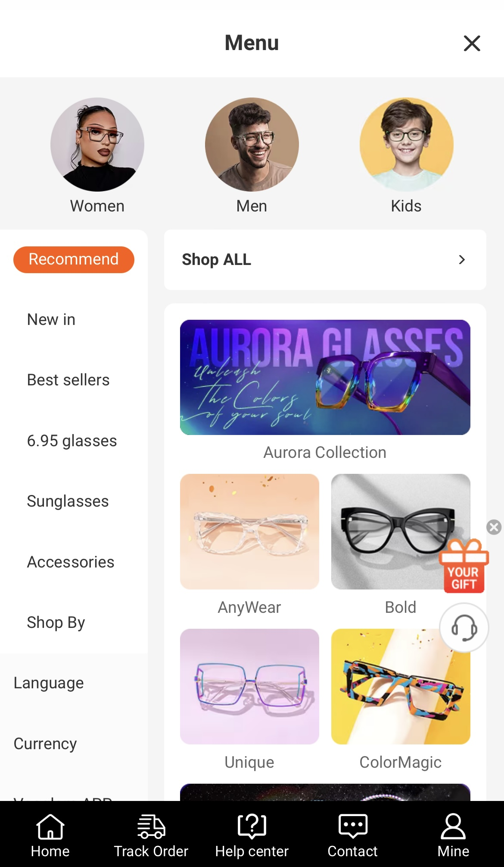
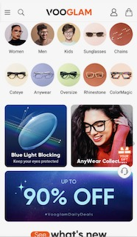
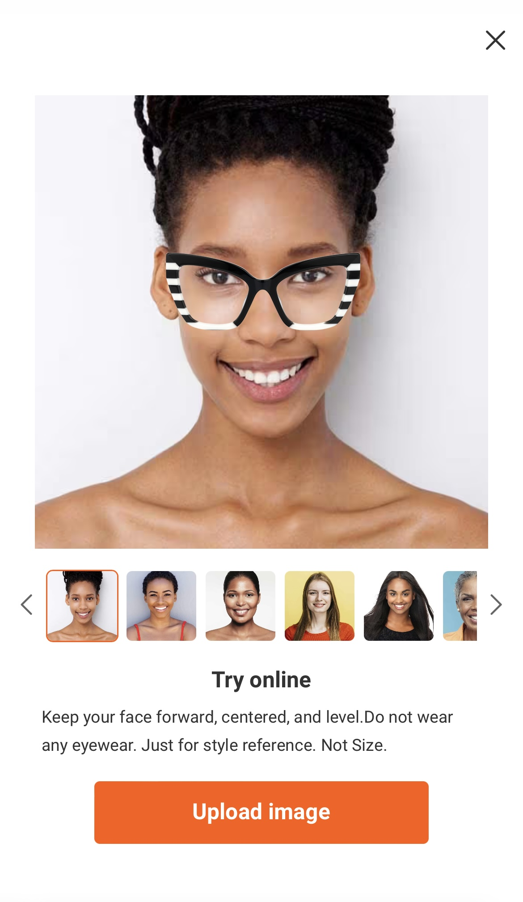
EXISTING APP RESEARCH
The next few slides will show examples of some existing e-commerce apps, and some that have VR/AR capabilities.
Vooglam
Pros:
Huge selection, if you click on the search bar it shows you “hot searches” with some picture examples
You can access FAQs right in the search bar section along with searching for frame styles
You can use the try on feature on the mobile website and if you download the app, you can use the AR function.
Cons:
There is a ton of information on the home page which seems a little overwhelming, it may be suitable for someone who has absolutely no idea what to look for/where to start.
The menu navigation is a little clunky because there is too much information. There are two separate menus in the menu, one on the left and one on the bottom with different options. There are a ton of photos with additional sections, the look is overall confusing and an eyesore.
The try on feature looks a little flat & does not allow you to rotate the product. It only works for head on photos.

Slide 7
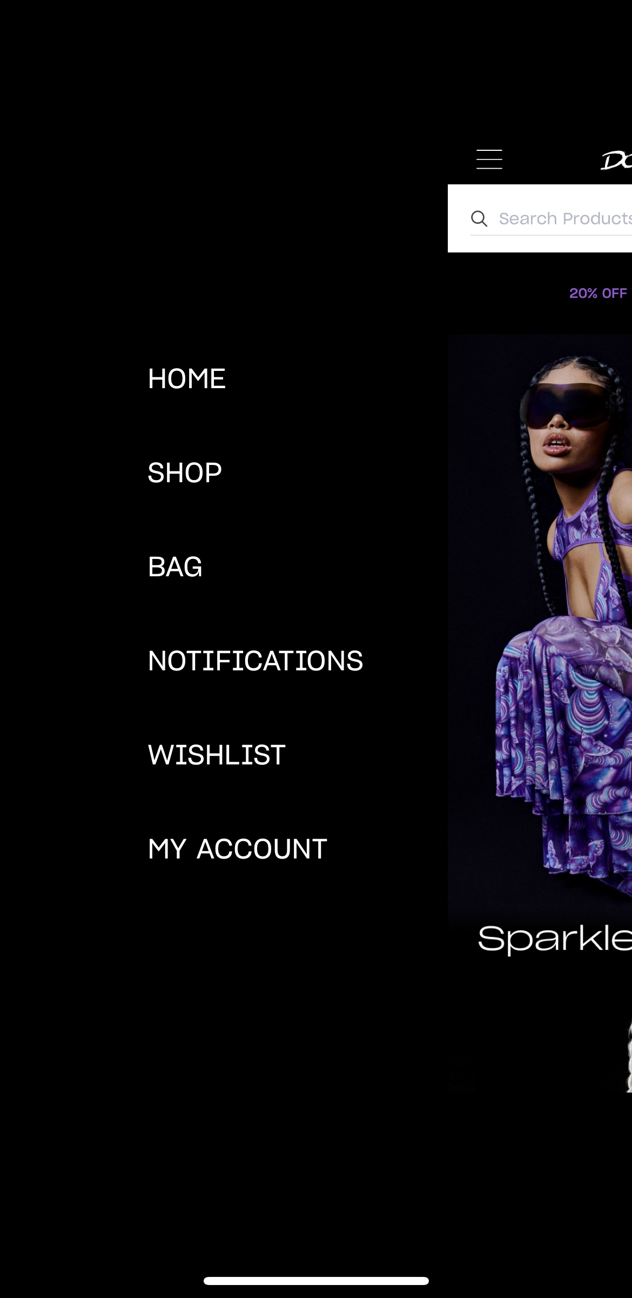
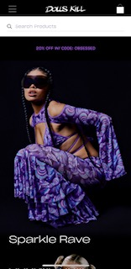
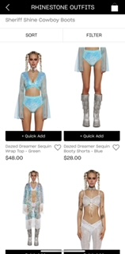
EXISTING APP RESEARCH
Dolls Kill
Pros:
Home page is well organized and visually appealing.
Adding items to cart is easy and checkout can be quick with express pay.
Cons:
No FAQs in app, only on the webpage.
The app is much more simplified that the webpage and is missing a lot of features and info. There doesn't seem to be any real benefit to using the app because the webpage is very responsive on its own.
In app error messages aren't in easy to understand language.

Slide 8
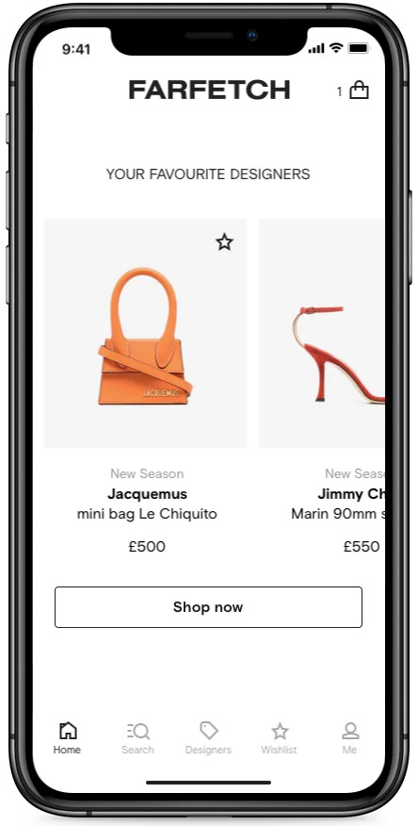
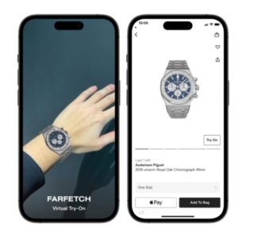
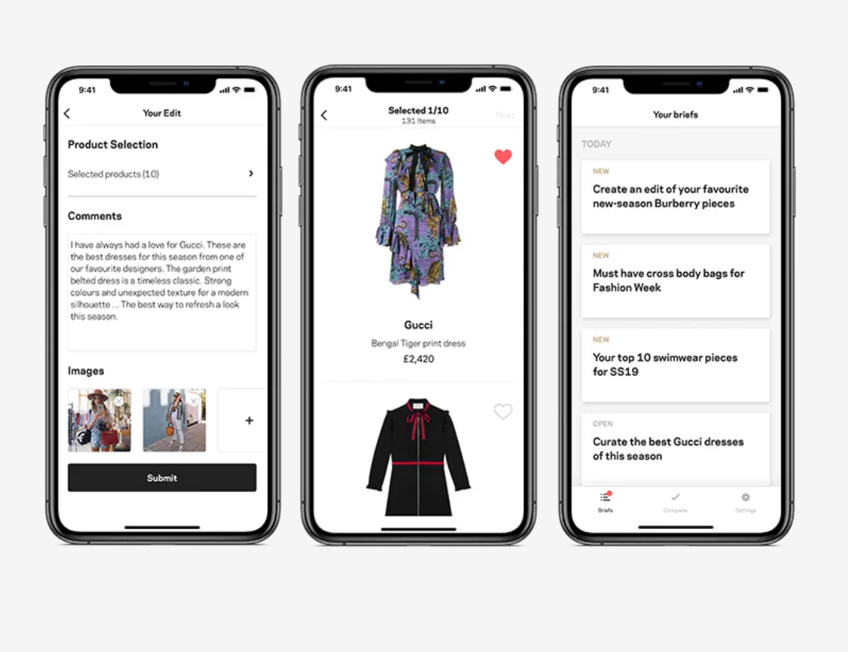
EXISTING APP RESEARCH
Far Fetch
Pros:
AR feature is high quality and looks realistic/3D but only certain items can be tried on, like watches jewelry and shoes.
Interface is clean and organized
Cons:
You have to look through a lot of inventory before you can find something to try on. There should be a section in the navigation that highlights which items/categories can be tried on.
This may be because Far Fetch isn't the brand and they actually sell many luxury brands, but the app seems a little uninspired and there isn't much branding that makes Far Fetch visually memorable.
You must create an account to use the app/browse at all

Slide 9
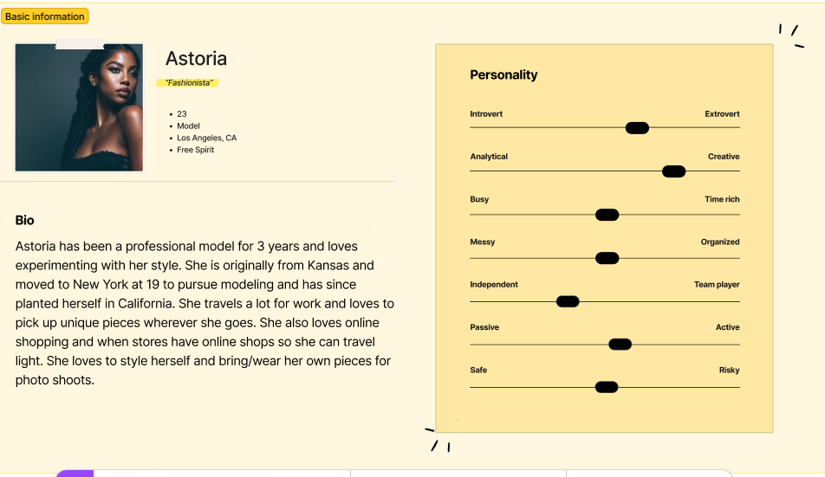
USER PERSONA A

Slide 10
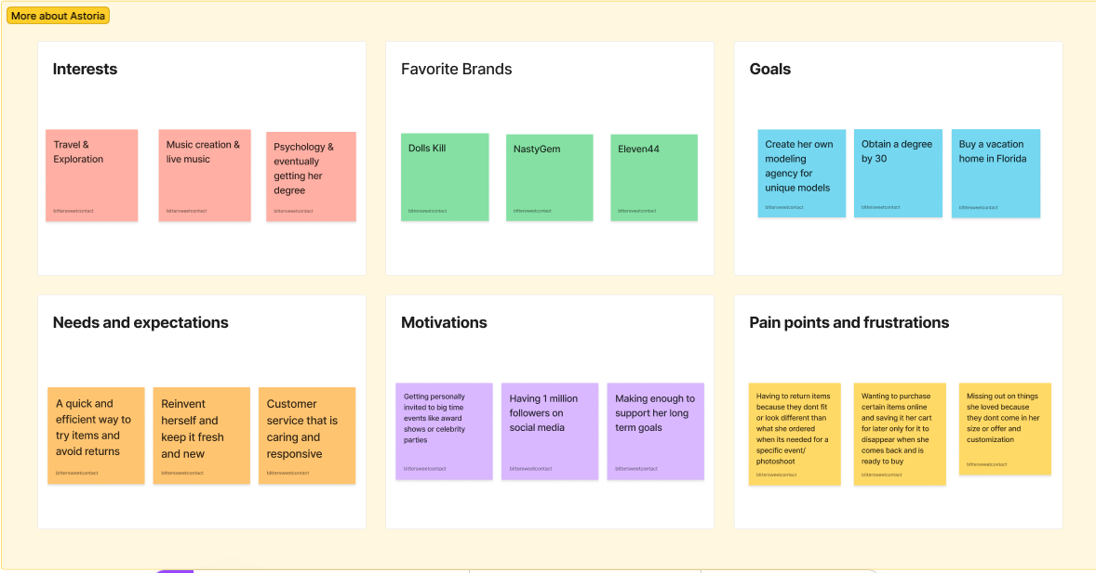
USER PERSONA A

Slide 11
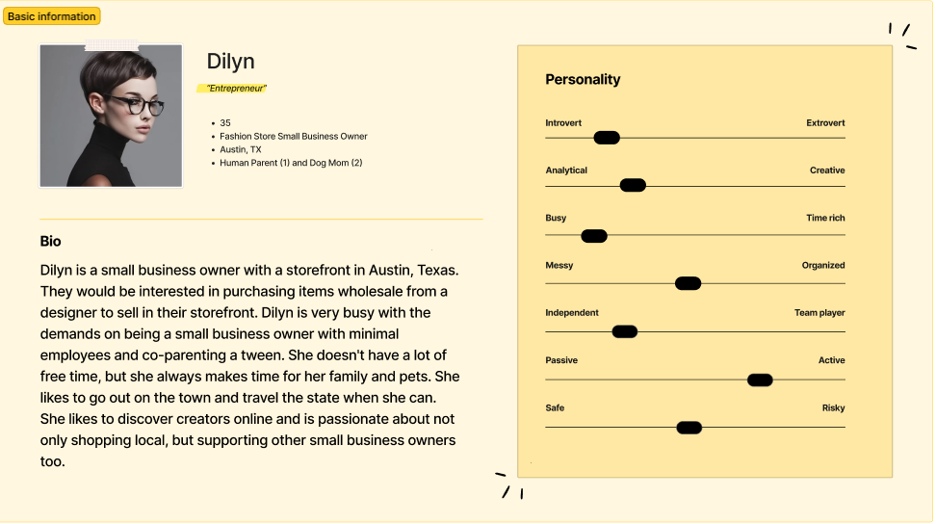
USER PERSONA B

Slide 12
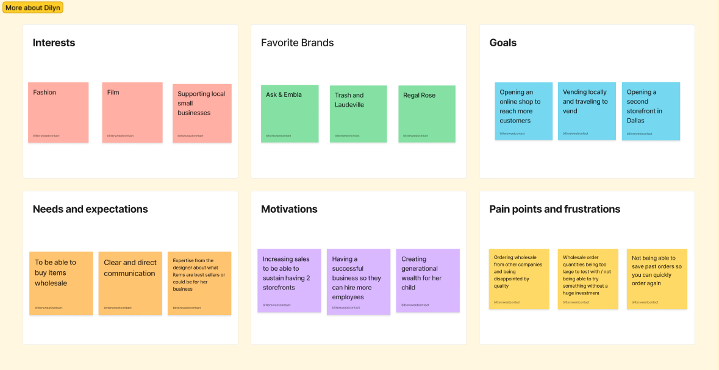
USER PERSONA B

Slide 13
TASK ANALYSIS
TASK 1
Browse inventory
TASK 2
Use try-on feature/Create an account
TASK 3
Make wholesale purchase/ create an account

Slide 14
Task ANALYSIS
TASK 1 - BROWSE INVENTORY
Landing page allows users to browse by having sections with labeled images to attract the customer.
Alternatively, if the customer would rather use the navigation, it will be in a hamburger menu with labels such as:
Home
Accessories(>shop by collection>collars>bracelets>belts>harness>one offs>stickers)
Apparel(>shirts>hoodies>hats)
Customs
Wholesale
FAQ
Contact
Clicking on any of these items will take you to the respective page with a collection of listings or more information on each topic.

Slide 15
Task ANALYSIS
TASK 2 - USE TRY-ON FEATURE/CREATE ACCOUNT
In order to use this feature users must create an account.
Let's say they find something that interests them in the “shop by collection” tab, they choose a necklace and and see a button beside it, “try on”.
They click and it generates a popup saying “you must sign in to use this feature, log in or create an account” They click create an account, the popup then generates a form which asks for full name, email, create password/password confirmation, and password requirements (later during check out they can enter address and payment info and save it. If they choose, can add birthday in accounts after account creation)
After confirming password, it automatically sends an email to confirm the account has been created.
Then they can unlock the upload image feature. The app asks for permission to access camera/camera roll in order to either take a photo in app, or to upload an existing camera roll photo.
They accept and choose to upload existing photos. The upload completes and shows their image at the bottom to click, it generates an image with the chosen necklace overlayed predictively on the image. They can drag and drop or resize the necklace slightly if necessary. These images will be saved into the account unless they delete them.

Slide 16
Task ANALYSIS
TASK 3 – MAKE WHOLESALE PURCHASE/CREATE ACCOUNT
The user is searching to see if the company accommodates wholesale orders. They click on the navigation and see toward the bottom “Wholesale”.
This leads to a page where it explains only certain items are available wholesale and if they don't see what they wanted they can email to request a special order with an image of the item(s),quantity, color(s) and accommodation for special orders may not be guaranteed. Creating an account is strongly advised for repeat wholesalers because you can log in one click renew your order, make adjustments, or schedule re-buy like a subscription.
Below this text prompt, the user sees some things that they like in the listing options featured on that page.
They choose not to create an account at this time because they just want to do a test run to see how their customers respond to these new items. They click on a T-shirt design and see the price and multiple drop downs of options for sizes, and choosing quantities of each size S-L and quantity of 10, 20, 50, & 100.
Price listed automatically changes with quantity selection. They choose 10 small, 10 medium, & 10 large.
They proceed to checkout where they are is asked to pay with express pay options or complete a form asking for name, email, shipping address, billing address, payment info, generates tax and shipping prices, check box sign up for mailing list etc. Before confirming the order, the interface asks if the user wants to create an account and save the info of the purchase which they then decide to follow through and all that is left to complete is create/confirm a password.

Slide 17
PROBLEM SCENARIO ANALYSIS
TASK 1 – BROWSE INVENTORY
Both Dilyn and Astoria will be using the interface for the first time and will need to browse the inventory thoroughly to figure out which items best suit them and their goals.
The interface should be well organized and easy to navigate with multiple entry points to find what they are looking for.
For example, the navigation has a category/subcategory for each type of item sold, and additionally you can choose on the home/landing page what section you want to view with images to give an idea of what sections might interest you.

Slide 18
PROBLEM SCENARIO ANALYSIS
TASK 2 – USE TRY ON FEATURE
TASK 3 – MAKE WHOLESALE PURCHASE
Astoria is a professional model who wants to add more eclectic items to her wardrobe and accessory collection.
She loves to experiment with different looks but has a tough time deciding what style is for her because it's hard to imagine what she would look like wearing something completely new or out of the ordinary.
It is not always practical to order several of something online, so she is looking for an online try before you buy alternative.
Dilyn is a small business owner with a storefront. They would be interested in purchasing items from an indie brand and handmade items wholesale to sell in their storefront to add flair to their inventory.
Dilyn is very busy with the demands of being a small business owner with minimal employees and parenting a tween.
They want a quick and reliable stockist to collaborate with who offer a smaller wholesale experience and they can potentially make repeat orders with.

Slide 19
USABILITY REQUIREMENTS
Q1
Is the interface compelling/visually attractive?
Q2
Was the checkout experience easy and flexible (you can easily go back and edit information/you can create an account without losing what's in your cart)?
Q3
Is account creation hassle-free and have minimal requirements for starting? (additional information can be added/saved during checkout and you aren't required to create an account to browse the app)
Q4
Are all necessary product categories provided and visible on the home page/Is navigating the website easy as a first time user?

Slide 20
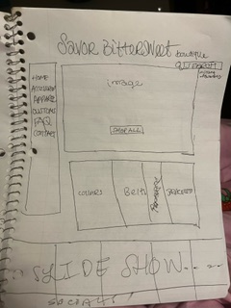
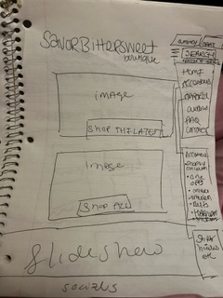
SKETCHES

Slide 21
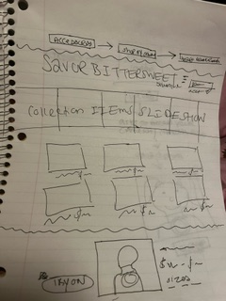
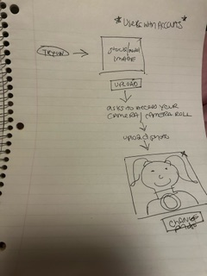
SKETCHES

Slide 22
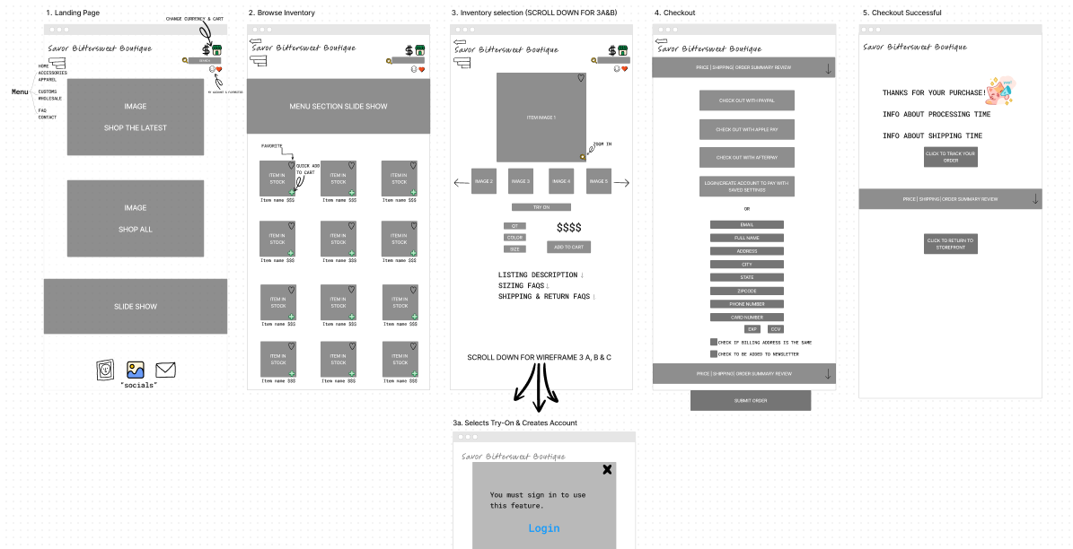
WIREFRAMEs
These wireframes read from left to right for a normal Browse and Checkout experience, or takes a detour downward from step 3 for the Virtual Try-On experience.
Visit https://www.figma.com/file/PmVEhFsR6WtyFvS1hLm2XG/UXUI-Wireframe?type=whiteboard&node-id=0%3A1&t=WXKSK1XroJiF5s9L-1
For a closer look and additional frames

Slide 23
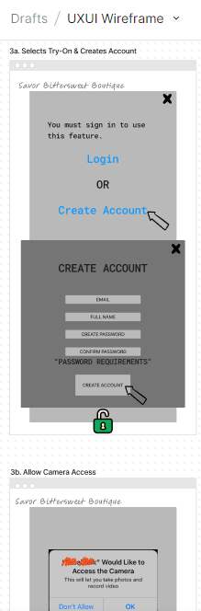
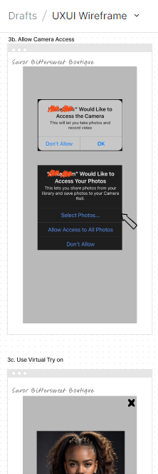
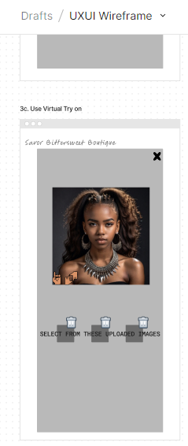
WIREFRAMEs
These wireframes read from left to right for a normal Browse and Checkout experience, or takes a detour downward from step 3 for the Virtual Try-On experience.
Visit https://www.figma.com/file/PmVEhFsR6WtyFvS1hLm2XG/UXUI-Wireframe?type=whiteboard&node-id=0%3A1&t=WXKSK1XroJiF5s9L-1
For a closer look and additional frames

Slide 24
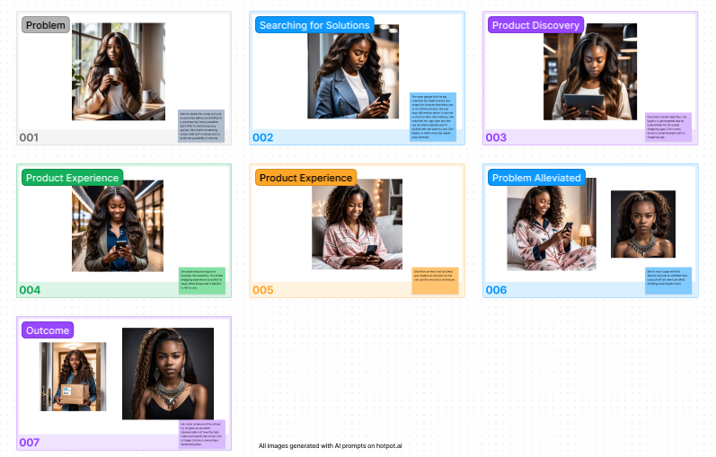
STORY BOARD
Visit https://www.figma.com/file/Ddpvzwb4uz6R4WMaCEo9er/Untitled?type=whiteboard&t=WXKSK1XroJiF5s9L-1 For a closer look

Slide 25
REFERENCES
Trends:
Blair, I. (2024). 10 Mobile Commerce Trends That Will Dominate 2024. BuildFire. https://buildfire.com/mobile-commerce-trends/
Websites and Apps Used:
Vooglam.com & Vooglam app
Dollskill.com & DollsKill app
FarFetch app

Slide 26
THANK YOU for watching

